Slide 1
SWITCHING Life TEST
FBG20N18

Slide 2
Switching LIFE
Tested variations of VDS voltage, IDS current and Switching Frequency in a high side buck converter over a 2000Hrs time
  VDS tested : 140V and 170V (Nominal) measured at Power supply and does not include any overshoot occurring at the DUT due to the buck circuit performance.
  Iout tested : 1A, 3A
  Parts tested with full parametric test on Focused tester at interim steps 48,hrs, 120hrs, 260hrs, 500hrs, 1000hrs, 2000hrs
  No failures have been observed so far thru 1500hrs

Slide 3
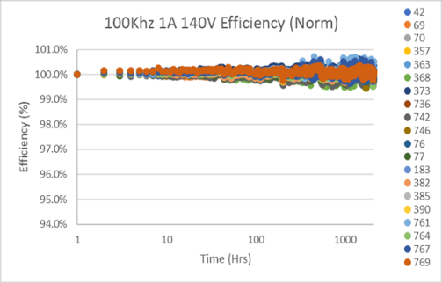
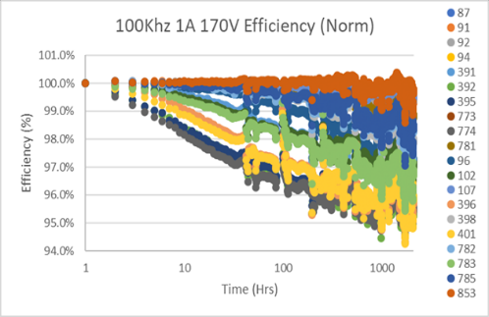
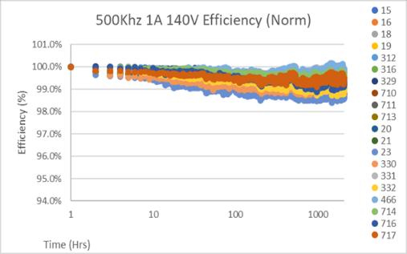
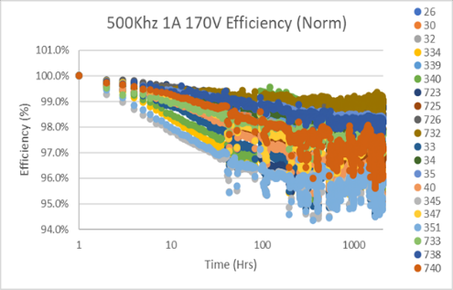
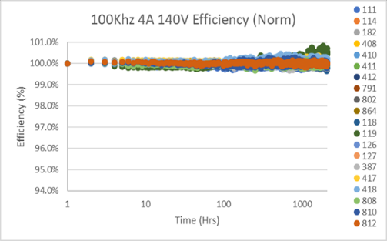
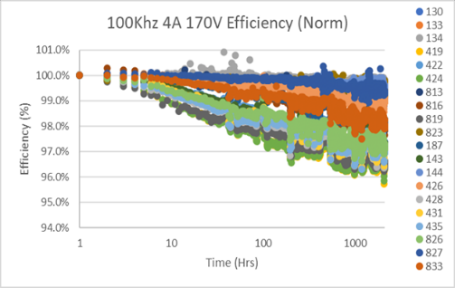
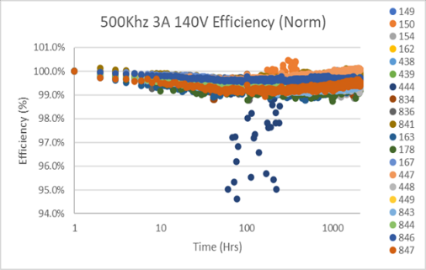
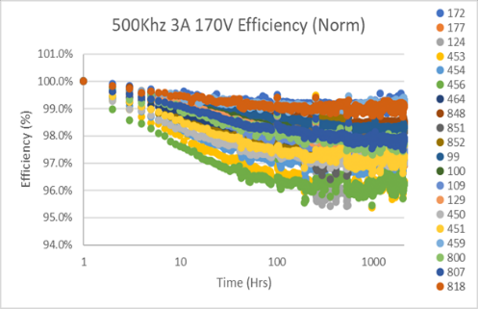
20N18 Efficiency Normalized
Take away : Efficiency dependent to drain voltage no current dependence .
Temperature seems to slow down the Drdson effect thru annealing . ( more pronounced on 100V device analysis)

Slide 4
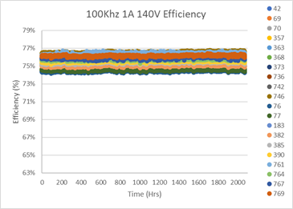
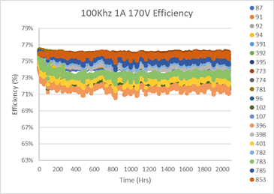
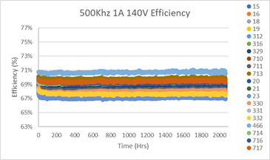
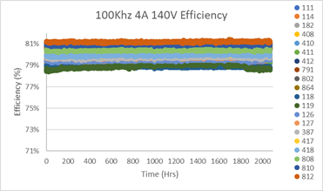
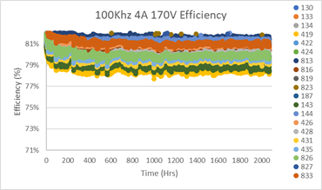
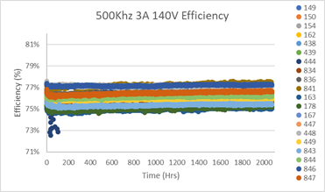
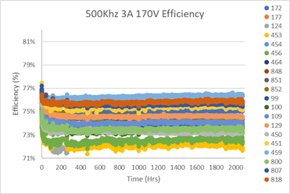
20N18 Efficiency (raw data)

Slide 5
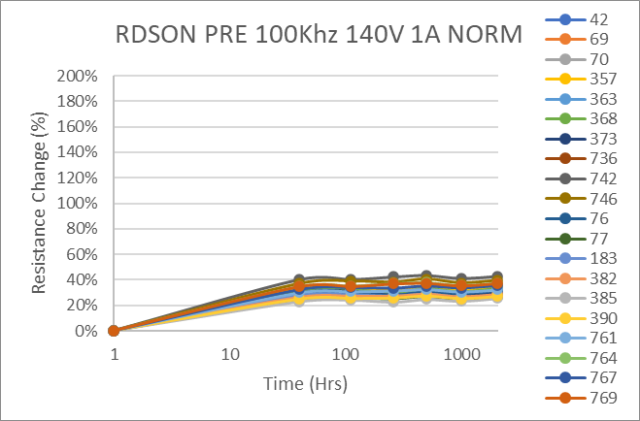
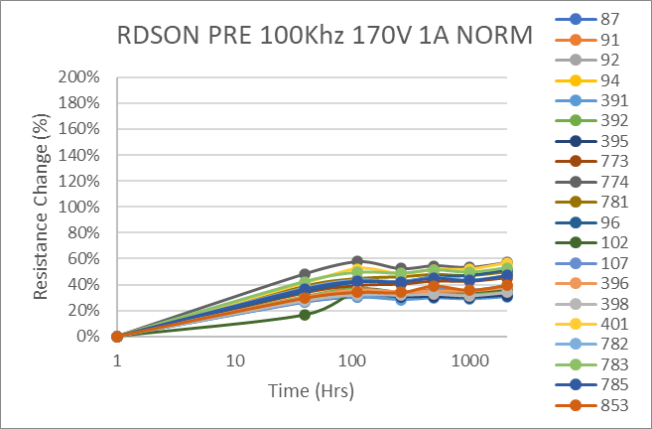
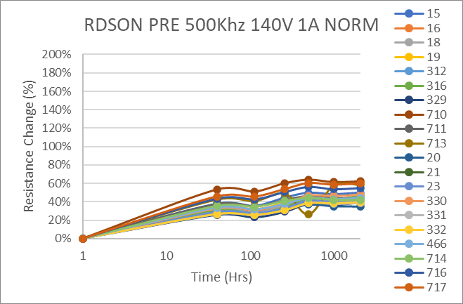
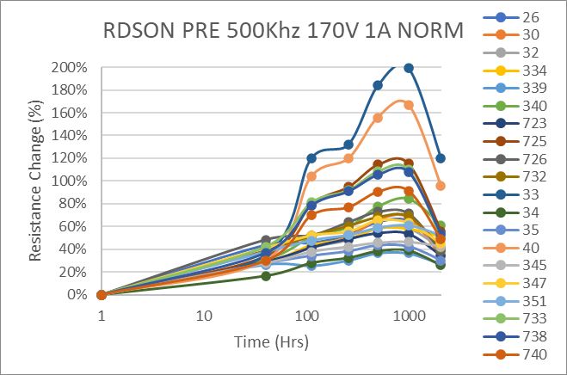
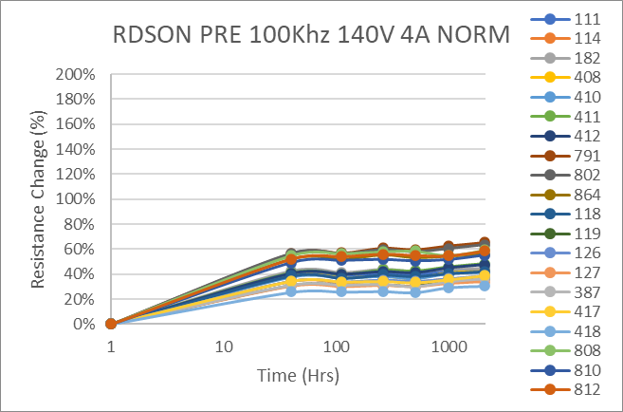
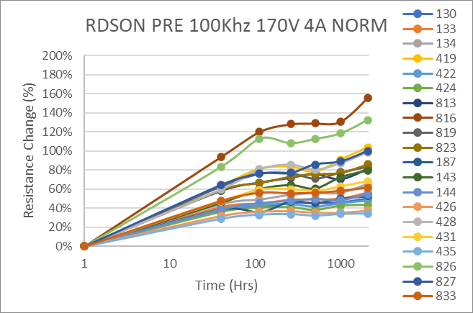
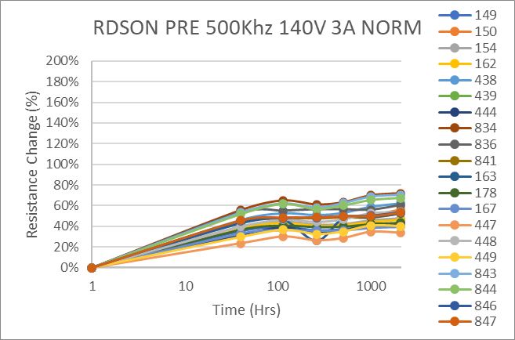
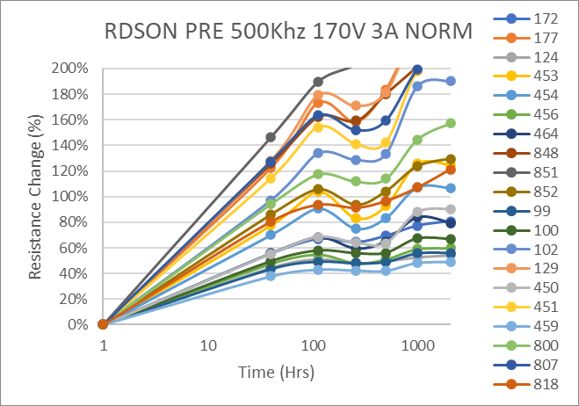
RDSON NORMALIZED
Take away : Rdson dependent to drain voltage no current dependence correlate to efficiency
Temperature seems to slow down the Drdson effect thru annealing . ( more pronounced on 100V device analysis)

Slide 6
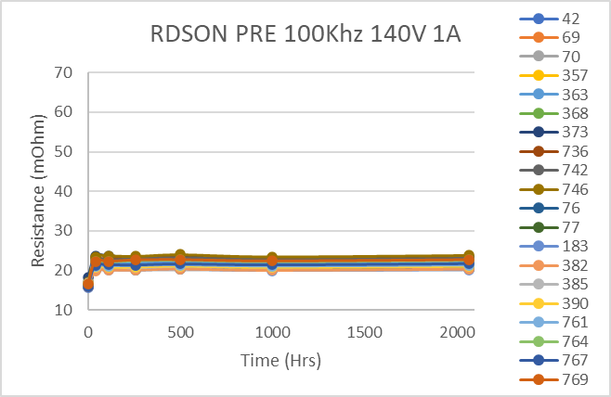
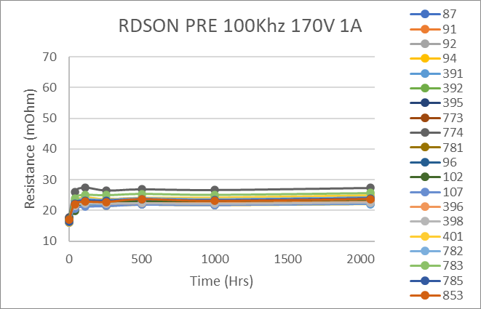
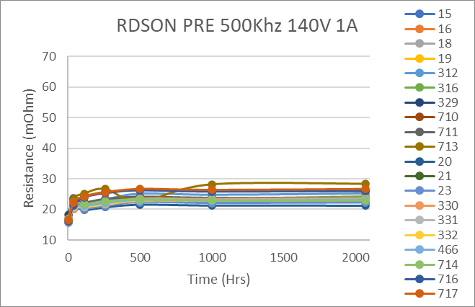
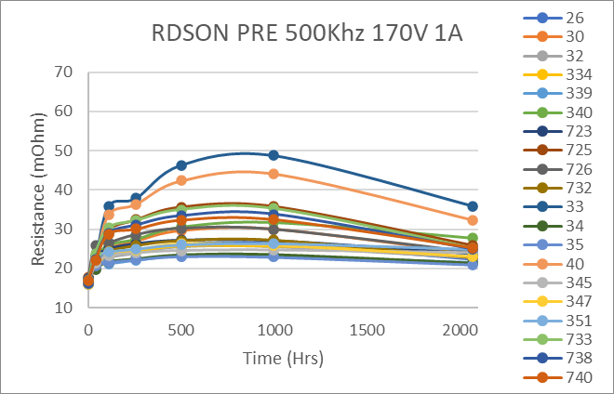
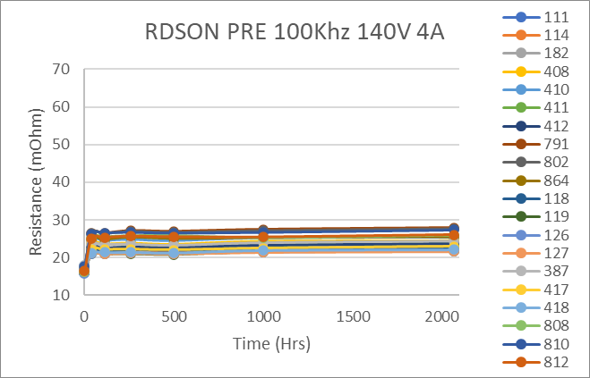
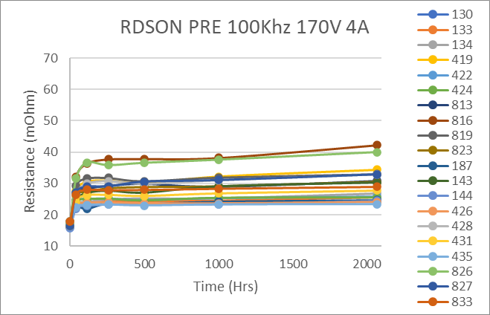
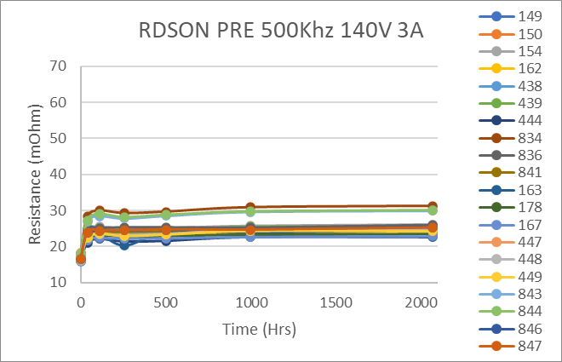
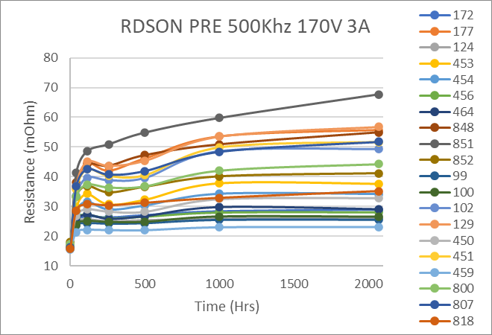
RDSON
Take away : Efficiency dependent to drain voltage no current dependence .
Temperature seems to slow down the Drdson effect thru annealing . ( more pronounced on 100V device analysis)

Slide 7
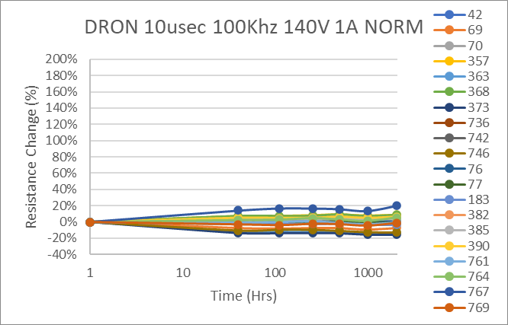
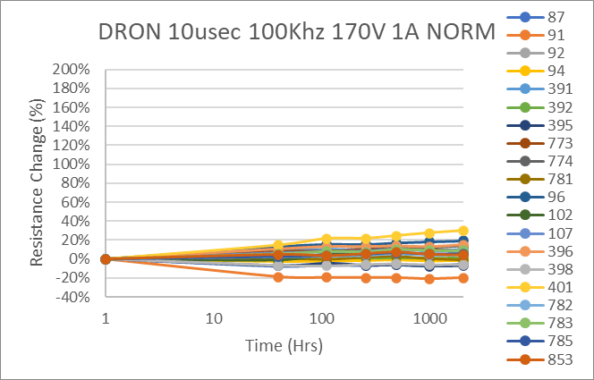
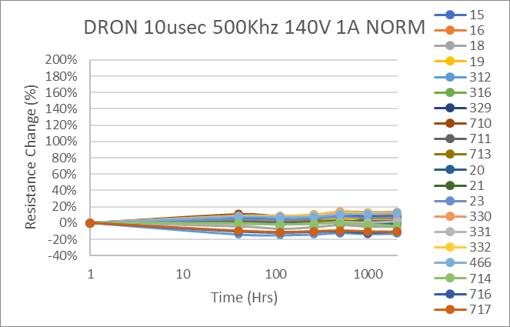
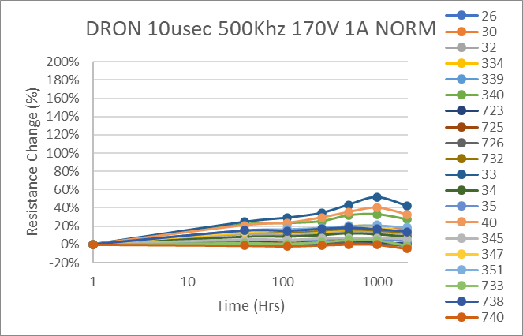
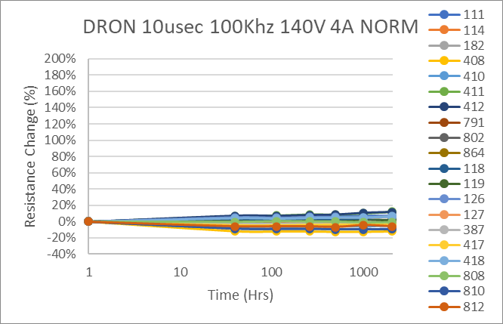
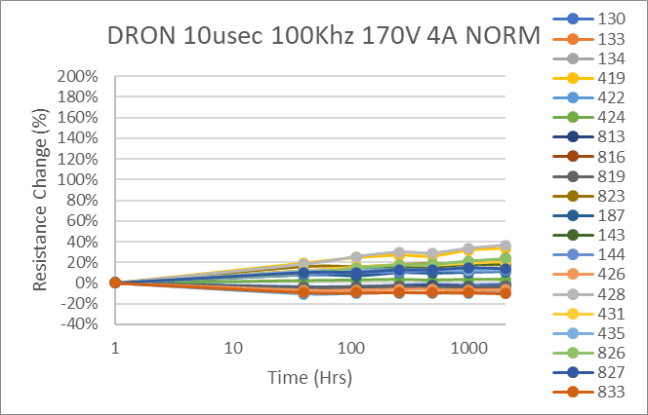
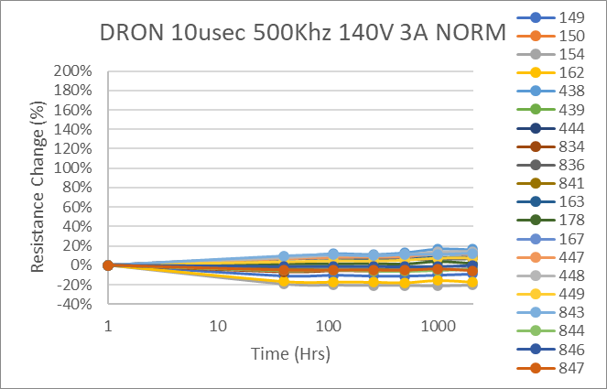
DRON Normalized
Take away : Drdon does not correlate to efficiency.
fast traps do nt seem to increase with longer stress compared to the slow traps (Rdson)

Slide 8
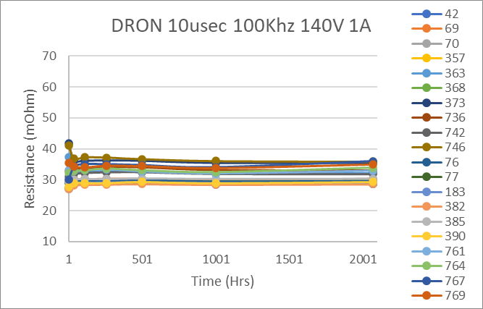
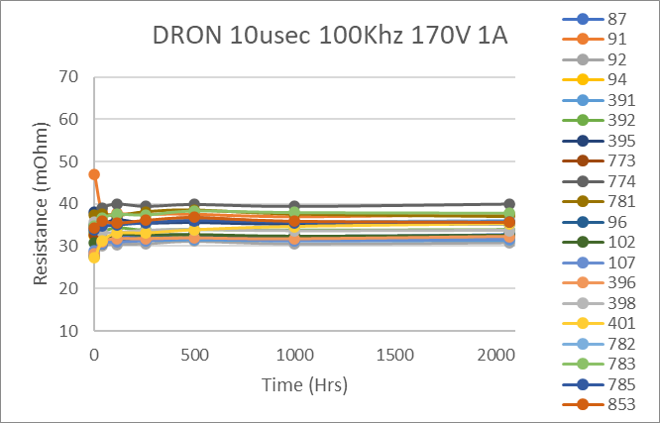
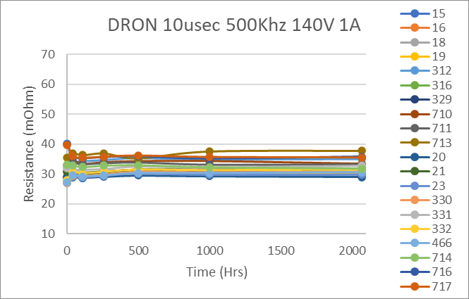
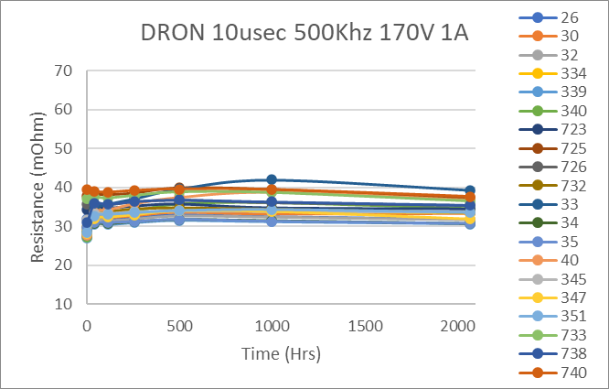
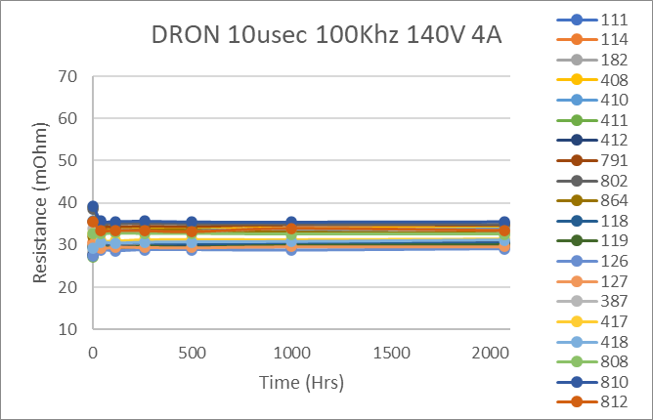
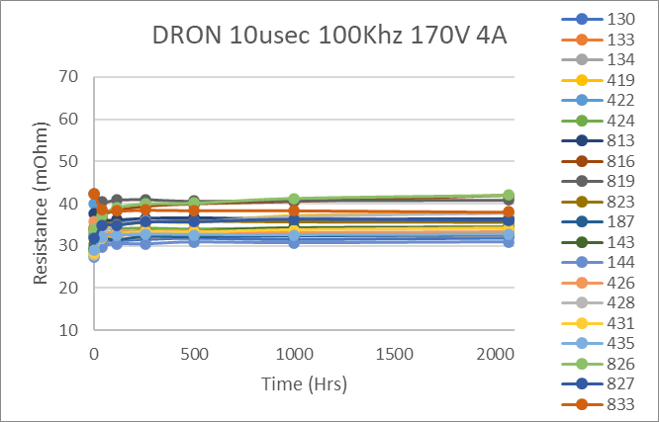
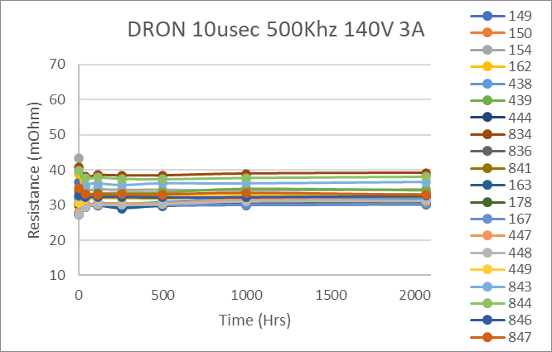
DRON

Slide 9
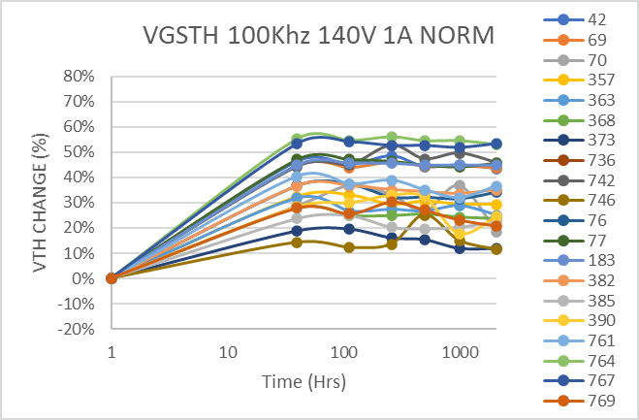
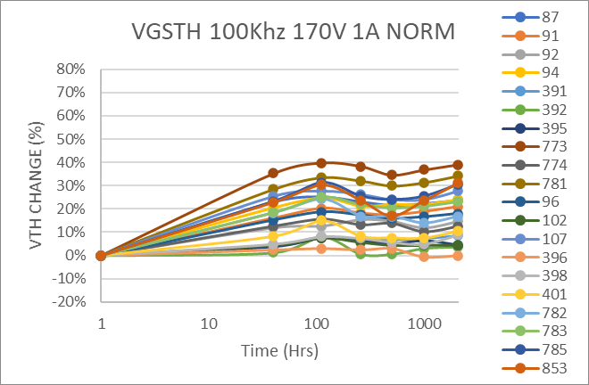
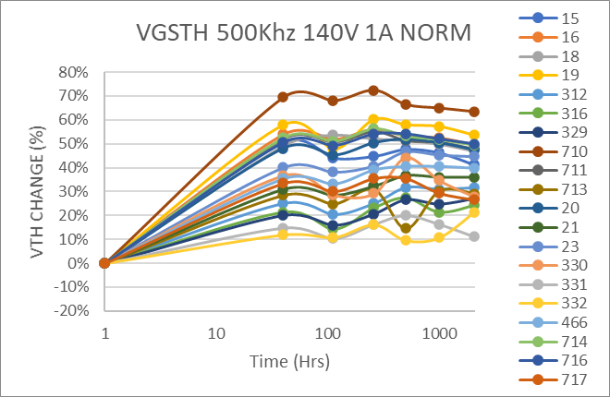
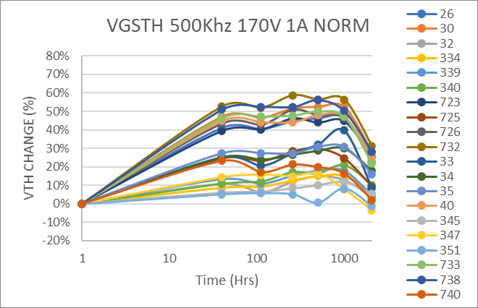
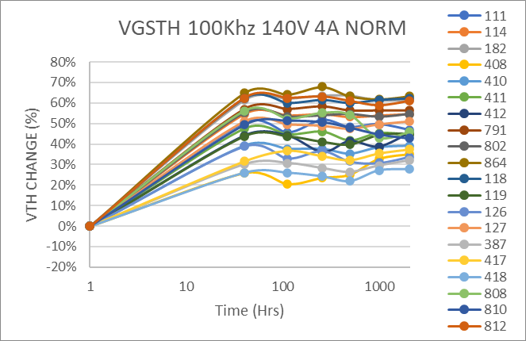



Vth Normalized
VTh performed pre Drdson and Idss on the Focused tester.
Initial shift but stable

Slide 10








Vth (raw data)

Slide 11








Vth-Post RDSON Test
VTh performed after Drdson and Idss on the Focused tester. Data
Talk to Rob S.

Slide 12








Vth-POST-PRE DELTA

Slide 13








IDSS
Leakages not affected

Slide 14








IGSS
Leakages not affected

